Slide 1
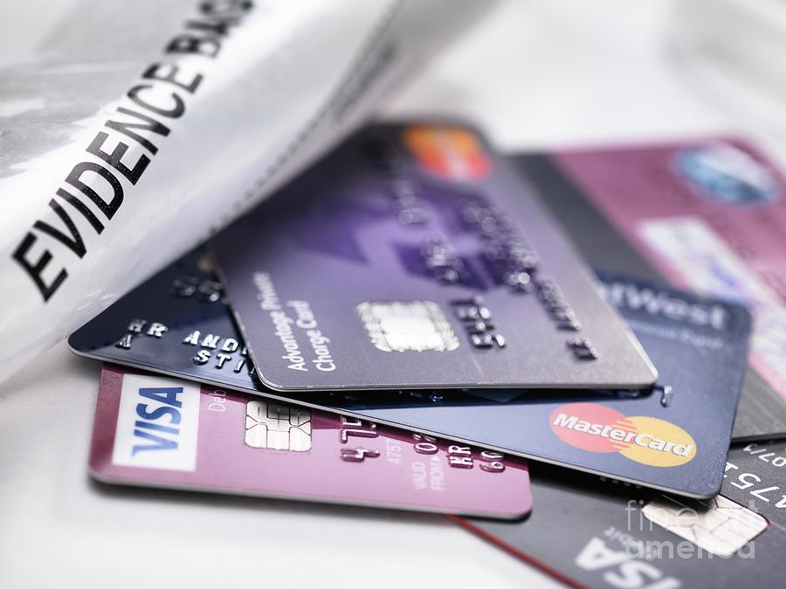
Credit Card Fraud Detection
Group 1
Ayush Joshi (C0905800)
Harsimran Kaur (C0908419)
Rutvik Prajapati (C0909130)
Saloni Shah (C0901921)
Sriveni Kunduru (C0876299)
Tamanna (C0909095)
Teghbeer Singh (C0901923)

Slide 2
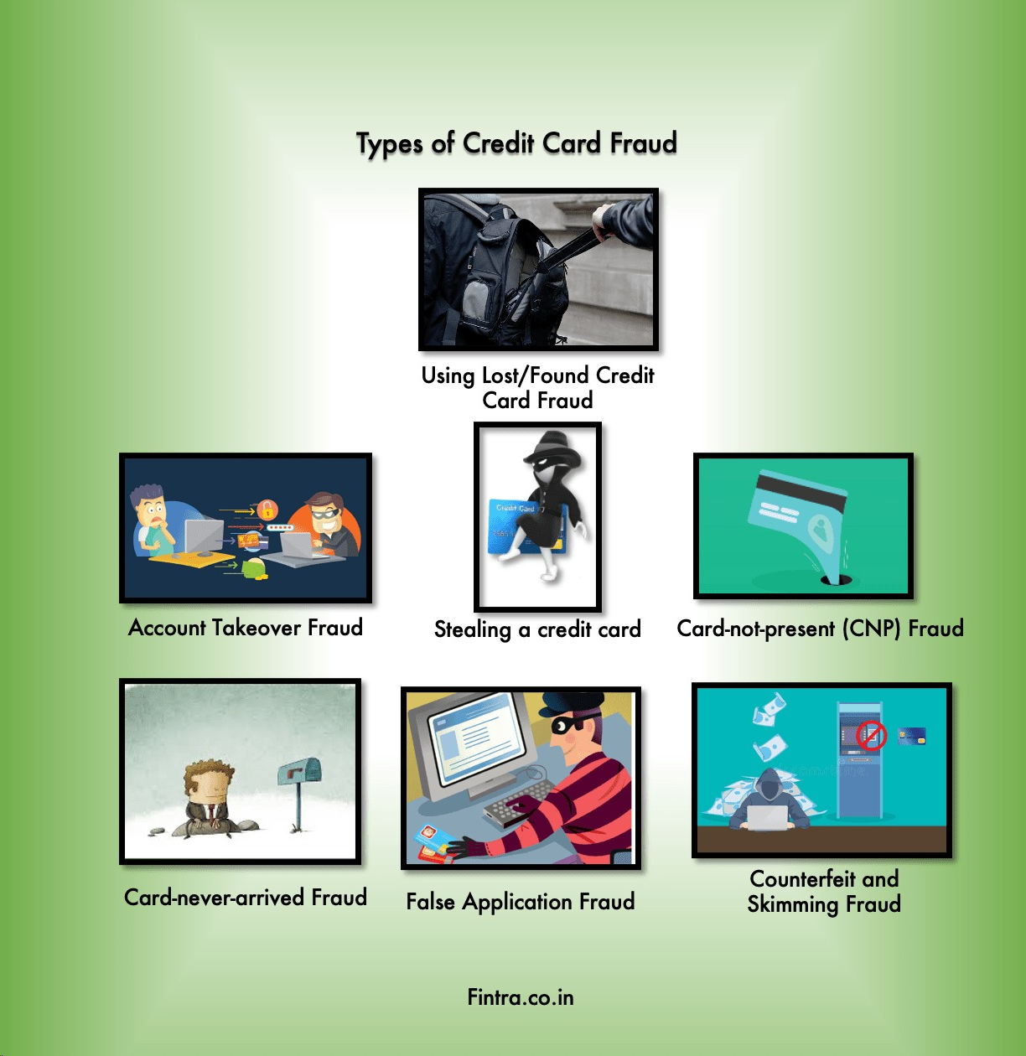
About the Fraud Industry
Data Acquisition:
Skimming, phishing, and system exploits to obtain cardholder data.
Counterfeit Creation & Illicit Transactions:
Fabricating cards and conducting fraudulent purchases.
Anonymization & Online Fraud:
Utilizing anonymization tactics and perpetrating card-not-present fraud.
.

Slide 3
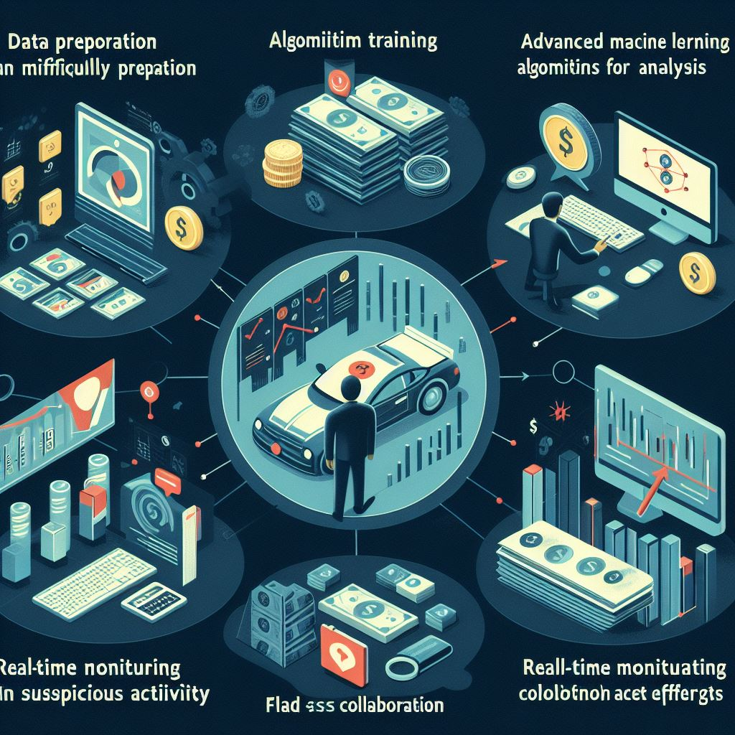
About the Detection Industry
Data Preparation: Financial data is collected and meticulously prepared for analysis.
Algorithm Training: Advanced machine learning algorithms are trained to detect fraudulent patterns.
Real-Time Monitoring & Collaboration: Systems monitor transactions in real-time, flagging suspicious activity, and collaboration enhances fraud detection efforts.

Slide 4
Problem Overview:
Credit card fraud detection requires quick and accurate identification of fraudulent transactions.
Current Limitations:
False Positives: Systems produce unnecessary alerts, costing time and money.
Delayed Detection: Fraudulent transactions can go unnoticed for too long.
Scalability Issues: Traditional methods struggle with increasing transaction volumes.
Difficulty with Complex Fraud Patterns: Systems lag behind evolving fraud tactics.
Proposed Solution & Objectives:
Develop an advanced fraud detection system using machine learning.
Implement real-time monitoring to swiftly identify and prevent fraud.
Improve scalability and efficiency to handle high transaction volumes.
Regularly update the system to adapt to changing fraud trends.

Slide 5
Differentiation
Utilization of Advanced Technologies:
We employ AI, ML, and data analytics to develop sophisticated fraud detection algorithms, surpassing traditional methods.
User-Friendly Interface and Transparency:
Our system prioritizes user experience with intuitive interfaces and transparent insights into the fraud detection process, fostering trust and understanding among stakeholders.

Slide 6
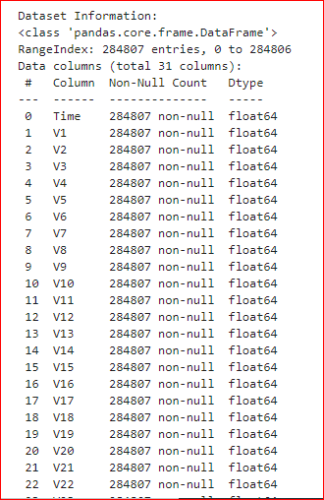
Understanding the Dataset
Dataset: Credit card transactions by European cardholders in 2013.
Size: Over 284,807 records.
Anonymization: Protects cardholders' identities, ensures privacy compliance.
Data Structure:
Tabular format with rows representing transactions.
Features include time, anonymized attributes (V1-V28), transaction amount, and fraud indicator (Class).
No null values present in the dataset.
Summary:
Provides comprehensive data for analyzing credit card transactions.
Facilitates fraud detection modeling using various machine learning techniques.
Opportunity to identify fraud patterns in merchant categories and transaction types.

Slide 7
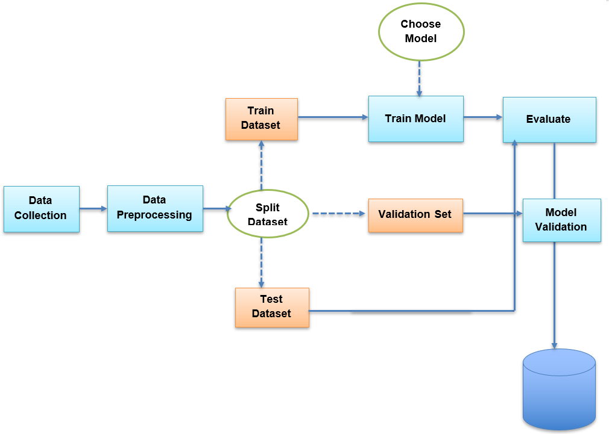
Project Workflow
Data Preprocessing:
Handle missing values, outliers, and normalize data.
Conduct feature engineering if necessary.
Model Selection:
Present ML models with concise strengths and weaknesses.
Model Training:
Train chosen models using training data.
Perform hyperparameter tuning.
Model Evaluation:
Assess models using accuracy, precision, recall, F1-score, and ROC-AUC.
Visualize performance with ROC or precision-recall curves.
Feature Importance:
Visualize key fraud detection features.
Model Deployment:
Deploy models using Flask or cloud services.
Performance Analysis:
Evaluate model performance on test data.
Analyze misclassifications for insights.

Slide 8
User Interface Workflow
Input Interface: Users input transaction attributes (time, amount, anonymized features).
Model Selection: Users choose ML model (logistic regression, random forest, SVM, etc.).
Data Preprocessing: Preprocess data for the selected model (handling missing values, scaling, etc.).
Model Prediction: Use selected model to predict fraud likelihood.
Result Display: Display prediction (fraudulent or not) and associated information (probability/confidence score).
Performance Evaluation: Optionally provide model performance metrics.
User Interaction : user-friendly UI with interactive elements like dropdown menus and buttons for efficient fraud detection.

Slide 9

THANK YOU

